Slide 1

Books popularity prediction
Using Data Scraping and Machine Learning methods
FINAL PROJECT
Assigned by Yaniv Levizada

Slide 2
Grading guidelines (For internal use)
Grading (basic): ̈ Project planning (proper research question and answer / conclusion) - (15) ̈ Data acquisition (using a pre-made dataset does not entitle for points, API entails only for 5 points) - (15) ̈ EDA quality and comprehension - (15) ̈ Machine Learning experiments and insights - (15) ̈ Proper understanding of presented material - (15) ̈ Presentation quality - (10)
Bonus: ̈ In class presentation - (5) ̈ Special data acquisition (crawling or other very special handling) - (10) ̈ Wow effect - (5) ̈ Single student - (5) ̈ Novelty of project - (10)

Slide 3

Research process - Walkthrough
First, let’s declare our research question:
Can we predict how successful a book would be, according to its characteristics?
In order to answer our question, we’d have to go through some different research phases:
Data Acquisition
EDA
Machine Learning
Conclusions of our research

Slide 4
Elaboration on research phases
1. Data Acquisition – Crawling the web and gathering all information in one csv file.
2. EDA – Filtering and cleaning the data, analyzing it and visualizing insights based on the data we acquired
3. Machine Learning – Using various ML techniques to help us predict popularity of a book, and benchmarking the performance of the models we chose for figuring the best one
4. Conclusions – After a thorough analysis of the data and designing a ML model, we state conclusions from the model regarding our research question.

Slide 5
Data sources
Data acquisition using scraping:
GoodReads
Note: Some websites want to prevent us from flooding their sites with requests or prevent automation, therefore they use pop-ups or any other techniques to prevent us doing so.
Fun Fact: Web scraping is about extracting the data from one or more websites, While crawling is about exploring URLs on the web.
Data Acquisition
EDA
Machine Learning
Conclusions
WOW EFFECT

Slide 6
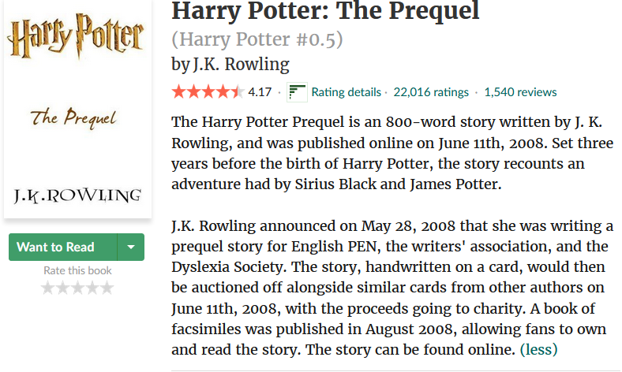


Goodreads
Goodreads is a website that contains A LOT of data about books and characteristics of each one of them. During the Data Acquisition phase, I implemented a method (named extract_data_html) that automatically randomizes a book ID and scrapes the corresponding web page on the website in order to get the relevant fields, and adds the data to a one big DataFrame.
This phase took a serious amount of time (about 3 days) because of repetition of the response code 403 (Acess Forbidden). So, in order to handle that restriction of acquiring data from Goodreads’s server, I ran the script twice, on 3 different computers.
Data Acquisition
EDA
Machine Learning
Conclusions
WOW EFFECT

Slide 7
EDA (exploratory data analysis)
At this phase of the research, we get to know the data we just acquired, filtering unwanted values such as nulls, checking for correlations in the data, balancing the data (there were too many book labels rated with 4 stars)
Visualizing the data to gain insights and understand the structure of our data set.
There were no duplicates in the data set as we iterated by chunks of a few millions on each iteration.
Handling outliers – Usually only numeric feature should be handled, in our data set – we will clean outliers that might mislead our model (# of pages and # of reviews)
Data Acquisition
EDA
Machine Learning
Conclusions
WOW EFFECT

Slide 8
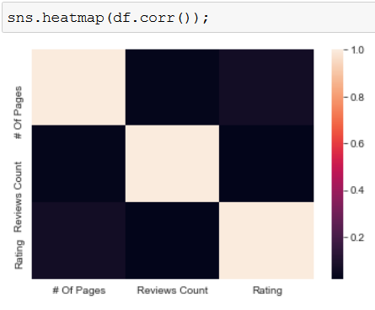
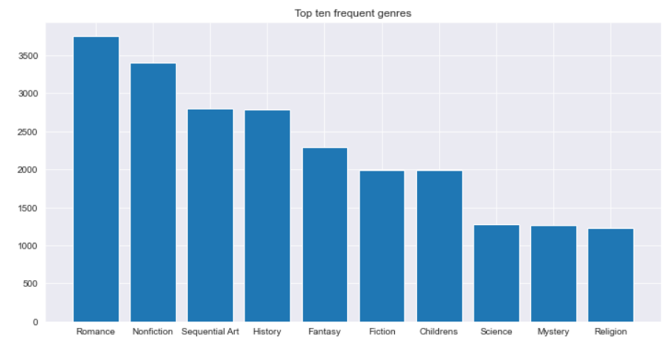
Let’s observe some insights:
There’s an insignificant correlation between the features in our data. (Which is good because correlation indicates dependency, which we DON’T want to see.
Here we used an histogram to describe the top 10 most frequent genres in our data set. Romance is most frequent section, followed by non-fiction (מציאותי)
WOW EFFECT
Conclusions
Machine Learning
EDA
Data Acquisition

